Slide 1

Christopher B. Barrett, Cornell University
Simon Brand Memorial Lecture
57th Agricultural Economics Association of South Africa Annual Conference
October 9, 2019
Inclusive, Sustainable, and Resilient Food Systems Transformation in Africa

Slide 2
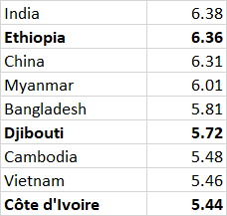
African economic growth
Africa is on the move.
3/9 world’s fastest growing economies are in Africa. Agriculture is at the heart of much of that growth.
Annual average real % GDP growth, 2014-18. Data source: World Bank

Slide 3
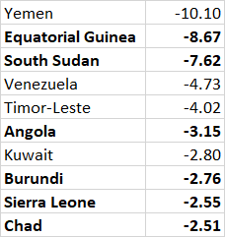
African economic growth
But elsewhere Africa is moving in the wrong direction.
6/10 world’s most rapidly contracting economies are in Africa. Rural communities are especially suffering. Conflict is key.
Annual average real % GDP growth, 2014-18. Data source: World Bank

Slide 4
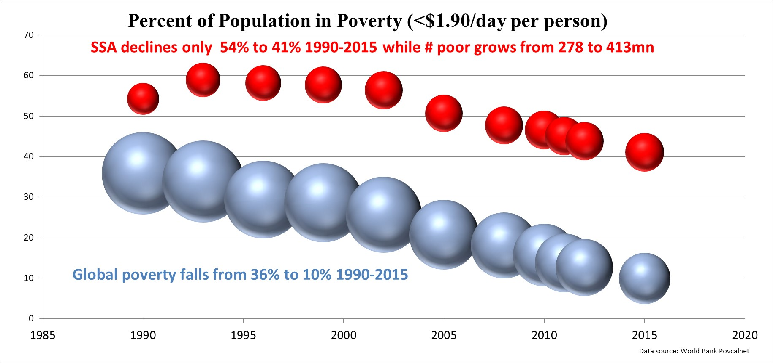
SSA headcount poverty rate fell from 54%-41%. But still >4x global rate. And SSA had 135 million more poor (≤ $1.90/day pc in 2011 int’l PPP) in 2015 than in 1990.
African poverty reduction

Slide 5
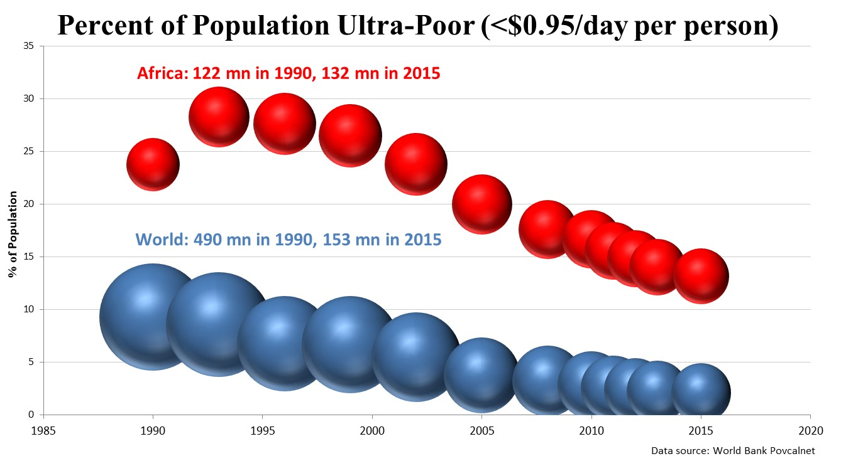
More worrying, ultra-poverty now almost exclusively African … SSA share of world’s ultra-poor grew from 25 to 87% 1990-2015.
African poverty reduction

Slide 6

“It was the best of times, it was the worst of times, it was the age of wisdom, it was the age of foolishness, it was the epoch of belief, it was the epoch of incredulity, it was the season of Light, it was the season of Darkness, it was the spring of hope, it was the winter of despair, we had everything before us, we had nothing before us, we were all going direct to Heaven, we were all going direct the other way …”
A Tale of Two Transitions
Africa experiencing – or risks – a “tale of two transitions”.

Slide 7
A Tale of Two Transitions
So how to promote a more inclusive, sustainable and resilient transition across the continent?
Food systems transformation is a necessary centerpiece in a continent that remains heavily rural and agrarian.
Moreover, prospective comparative advantage in agri-food value chains, given impending demand growth, land and water availability, potential for productivity growth, etc.
Agricultural economists across the continent must play a central role. As the leading nation in African higher education, South African agricultural economists can/must contribute.

Slide 8
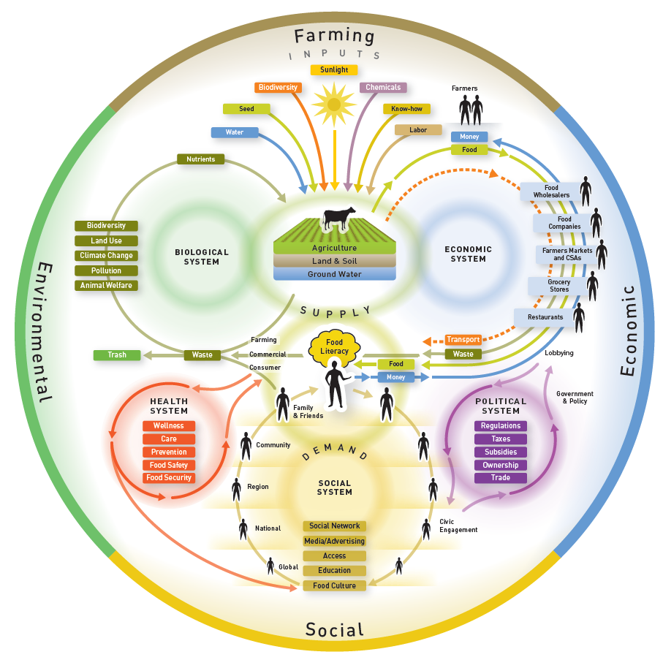
Food systems transformation
What are the food systems? And what must transform?
Complex interactions among:
Farmers turn natural/manmade inputs into feedstocks/food.
Post-harvest value chain to meet consumer food demand
Consumer behavior, driven by income, prices, culture, etc.
Social institutions/policies that condition behaviors
© WordLink www.nourishlife.org
#s 3/4 biggest drivers, although #s 1/2 most common entry points.

Slide 9
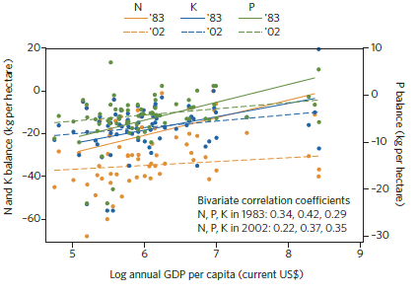
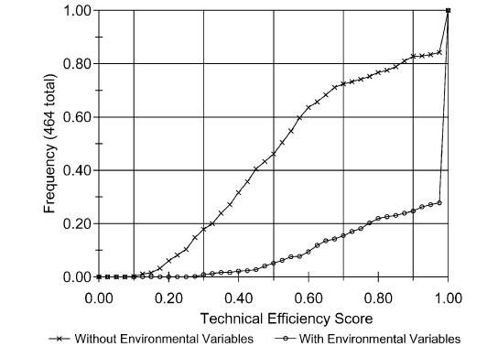
African ag tech change
Primary production
Ag productivity depends heavily on natural environment
Climate – temp, rainfall, extreme events. Must adapt!
Soils and water: regenerative ag great, but cannot overcome rapid forest/wetlands loss. Must work on building/maintaining soils and water while intensifying output. Sustainability is central.
Poverty traps can exist due to natural resources degradation.
Soil nutrient fluxes and per capita GDP, 36 SSA economies
Distribution of Ivorien rice farmers’ estimated plot-level technical efficiency
Median is on PPF w/env. controls 52% w/o controls
Source: Barrett & Bevis, Nature Geoscience 2015
Source: Sherlund, Barrett & Adesina, JDE 2002

Slide 10
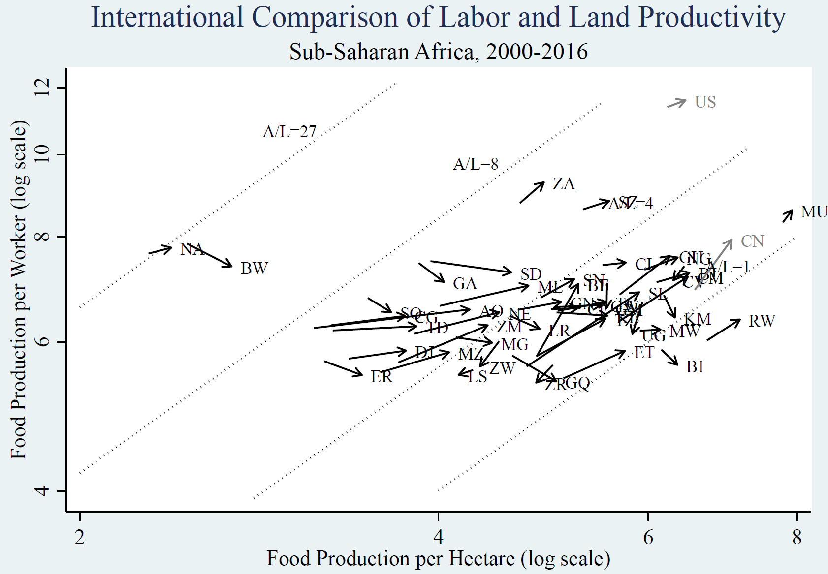
Primary production
Gains in African ag productivity respectable in many places, but coming mainly in land rather than labor productivity. Ag labor productivity growth is key to inclusive, sustainable growth.

Slide 11
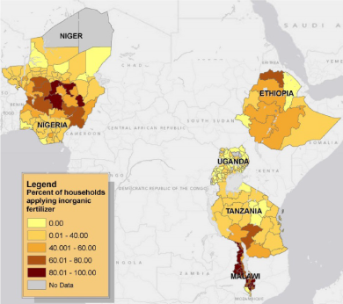
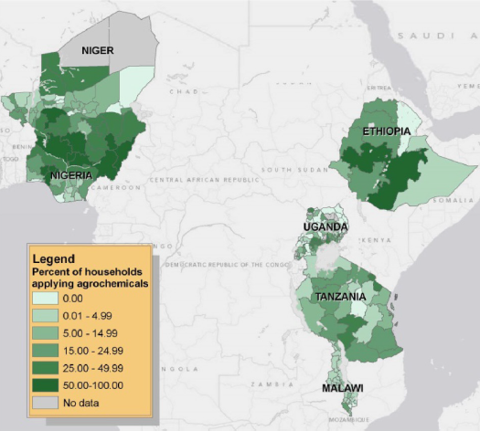
Primary production
Partly this is heterogeneous uptake of innovations
LSMS-ISA data show that uptake of modern fertilizer/agro-chemical uptake varies both within and among countries.
Sheahan and Barrett, Food Policy 2017

Slide 12
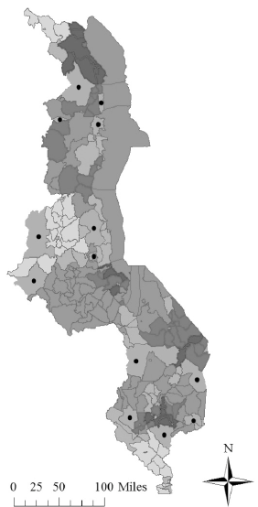
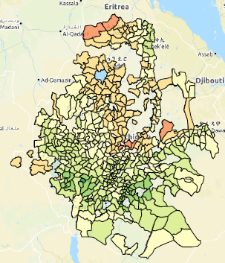
African ag tech change
Primary production
Which likely reflects in part heterogeneous returns due to soils, weather, market access, etc.
Probably relatedly, a number of recent studies find spatially heterogeneous returns to inputs:
Suri (EMTRA 2011)
- Kenya hybrid maize seed
McCullough et al. (WP 2018)
- Ethiopia fertilizer
Burke et al. (AgEcon 2016)
- Zambia fertilizer
Harou et al. (JAfrEcon 2017)
- Malawi fertilizer
Aggarwal et al. (NBER 2019)
- Tanzania fertilizer
https://www.ag-analytics.org/AgRiskManagement/EthiopiaGeoApp

Slide 13
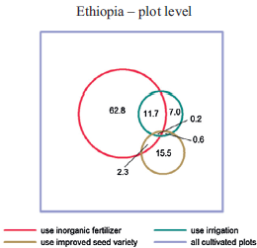
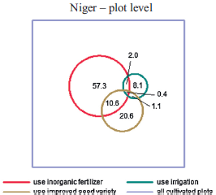
African ag tech change
Primary production
But even highly uneven adoption within households
LSMS-ISA data show little joint uptake of modern ag inputs despite agronomic synergies and contrary to ISFM principles.
(Sheahan & Barrett, Food Policy 2017)

Slide 14
African ag tech change
Primary production
And national-level (policy and cultural) factors - explain nearly half of farm-level variation in fertilizer/agro-chem use.
Variation in household-level inorganic fertilizer use
Categories of variables | Shapley value
Bio-physical variables: rain, soil, elevation, maximum greenness, agro-ecological zones | 24
Socio-economic variables: consumption level, sex of household head, household size, dependency ratio | 4
Farm characteristic variables: farm size, number of crops, type of crops | 16
Market and accessibility variables: distance to market and road, prices of fertilizer and main grain | 11
Country dummy variables | 45
Ethiopia, Malawi, Niger, Nigeria, Tanzania, Uganda 2010-12 LSMS-ISA data. n = 22,214 households; overall R² = 0.393. Source: Sheahan & Barrett, Food Policy 2017
Policy and context facilitated by governments, large firms, and regional processes (e.g., CAADP) are critically important to ag productivity growth in SSA.

Slide 15
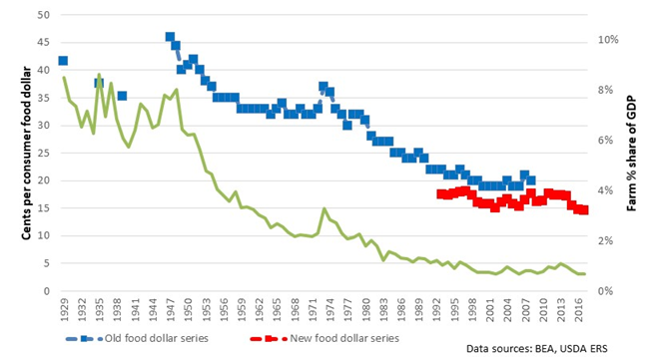
African ag tech change
Post-harvest value chain
As economies expand, consumer demand for non-nutritive food attributes (appearance, convenience, packaging, safety, taste, etc.) grows. Thus the farmer share of consumer food expenditures falls. The US historical experience offers a useful illustration.
US Farm Share of Consumer Food Expenditures and
Gross Farm Value Added Share of GDP, 1929-2017
Source: Barrett et al. 2019
Note: in South Africa, estimated farm share 2005-15 was ~26% of food consumed at home, ~7% of food consumed away from home.

Slide 16
African ag tech change
Post-harvest value chain
Product/process innovation is the main driver of value chain transformation.
Firms seek (temp) profits, via new mkt opportunities.
Far larger employment, environmental, and health impacts come from the post-harvest chain than from primary production.
We know far too little about these impacts and processes.
Source: Barrett et al. 2019

Slide 17
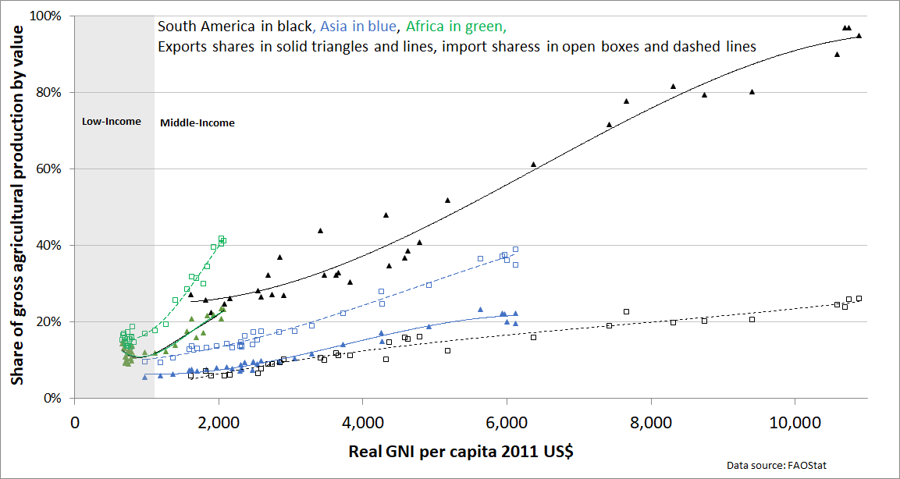
African ag tech change
Post-harvest value chain
Need more focus on domestic market opportunities, not just int’l trade. Across Africa, ag exports only ~7% of domestic consumption. In low-income range, gross exports/imports consistently <20% of production.
Source: Barrett et al. 2019

Slide 18
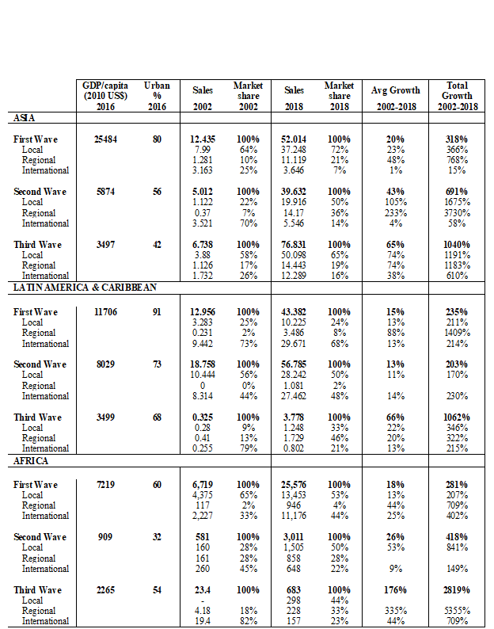
African ag tech change
Post-harvest value chain
Downstream opportunities growing fast, driven by growing urban consumer demand, improved logistics, policy reforms, etc.
Total edible grocery sales of leading retail chains in Africa, 2002-2018 (nominal USD mn)
Data source: www.Planetretail.net. First wave: Botswana, Namibia and South Africa. Second wave: Kenya, Madagascar, Malawi, Mozambique, Tanzania, Zambia , Zimbabwe. Third wave: Angola, Ghana, Nigeria, Senegal.
Source: Barrett et al. 2019

Slide 19
African ag tech change
Post-harvest value chain
Gross sales leading café, fast food, and restaurant chains in Africa, 2008-2018 (nominal USD mn)
Data source: retail food service chain-country pairs from www.Planetretail.net. Firms represented: Fast Food Restaurants: A&W All American Food; Baskin-Robbins; Burger King; California; Cold Stone Creamery; Domino's; Doña Tota; East Dawning; Harajuku Delights; KFC; Long John Silver's; McDonald's; Pizza Hut; Seaport; Subway; Taco Bell; Taco Bell Grande; Wendy's. Cafés: 85 degrees C; Au Bon Pain; Cafe Brio; Dunkin' Donuts; Pacific Coffee; Sanborns Café; Starbucks; Restaurants: Afternoon Tea; Applebee's; BHG Kitchen; Chili´s; IHOP; KAZOKUTEI; Little Sheep; LongHorn Steakhouse; Maxim's; Olive Garden; Red Lobster; Rock and Roll; S&R QSR; SHUN-NO-MAI; Super Quick; The Capital Grille; Vips.
Source: Barrett et al. 2019

Slide 20
African ag tech change
Food consumer behavior
But are the poor enjoying lower prices, better food safety, and enhanced dietary diversity by these developments? Unclear.
Emergent ‘triple burden’ of undernourishment (PEM), micronutrient (mineral/vitamin) deficiency, and obesity.
Lots of anecdotal evidence of a ‘tale of two (nutritional) transitions’. Need firmer quantitative analysis.
We do know that Africa remains the continent with, by far, highest prevalence of food insecurity.

Slide 21

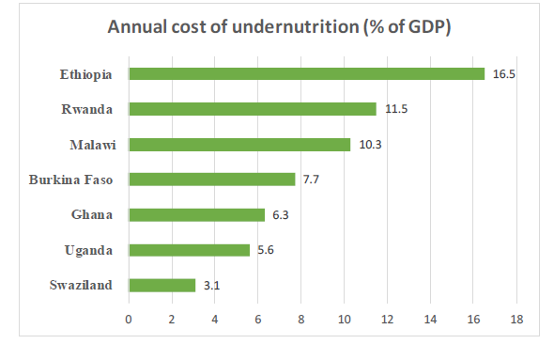
African ag tech change
Food consumer behavior
Poverty is a major driver of undernutrition, which itself begets poverty and slowed economic growth in a vicious cycle
… a specific form of poverty trap.
Source: ACPF 2019

Slide 22
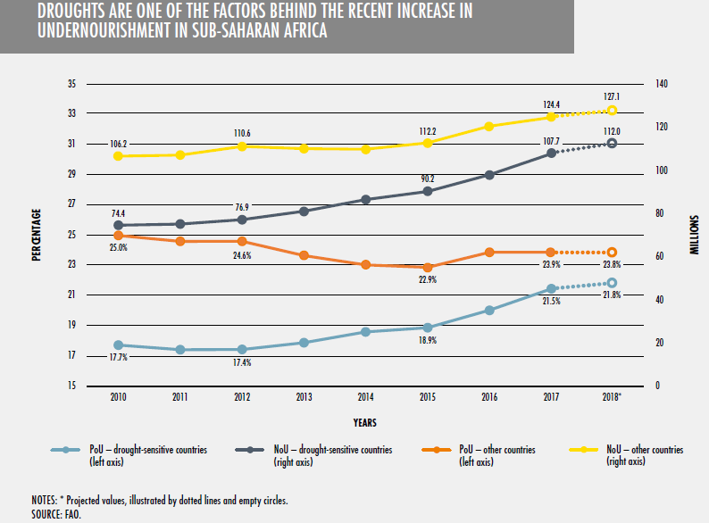
Resilience
Uninsured risk is a major cause of both chronic poverty and undernutrition. Building resilience to natural and manmade shocks is essential to inclusive and sustainable food systems transformation. Climate anomalies – esp. drought – are a major challenge in Africa.
Notes:
SSA (working poor): 20, Other Developing countries: 41
Angola Malawi
Burkina Faso Mauritania
Cameroon Mozambique
Congo, Dem. Rep. Niger
Cote d'Ivoire Rwanda
Gabon Senegal
Ghana Sierra Leone
Kenya Tanzania
Liberia Togo
Madagascar Zambia
Agriculture: agriculture, hunting, fishing, etc.
Industry: mining, manufacturing, public utility services, construction
Services: retail, hotels, transport and telecommunications, finance and business services, public administration, other services, and unspecified

Slide 23

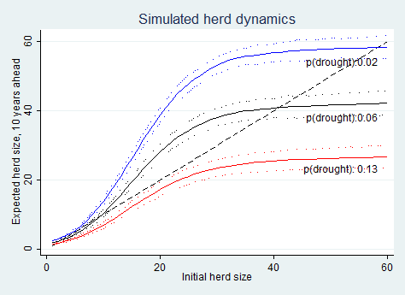
Resilience
Ex: East African pastoralist systems exhibit poverty traps arising from drought shocks. What happens if climate shifts?
Herd dynamics differ b/n good and poor rainfall states, so change w/ drought (<250 mm/yr) risk.
In so. Ethiopia, doubling drought risk would lead to expected system collapse if no disruption to current herd dynamics.
Source: Barrett and Santos (Ecol Econ 2014)

Slide 24
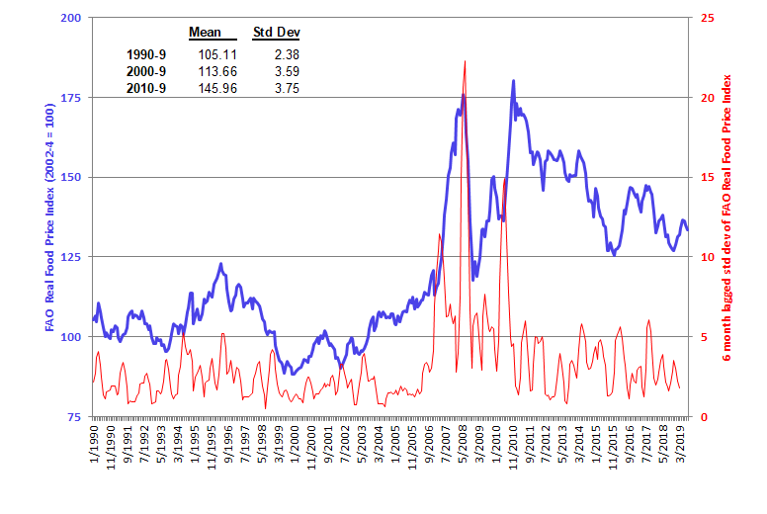
Resilience
Also must address higher and more volatile food prices, which are likely to continue, esp. with trade wars and macro uncertainty.

Slide 25
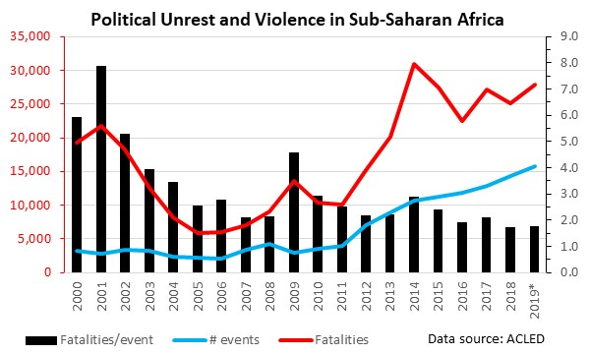
Resilience
Perhaps greatest problem is conflict risk and associated damages.
High direct costs of conflict (loss of lives/property, impacts on health, education, prices, productivity) but indirect costs of conflict risk exposure even bigger and have especially big effects in rural areas. (Bundervoet et al. JHR 2009, Akresh et al. EDCC 2011/JDE 2012, Rockmore WBER 2016)
Risk preferences and other behavioral effects can persist for years (Voors et al. AER 2012, Rockmore, Barrett & Annan 2019, etc.)

Slide 26

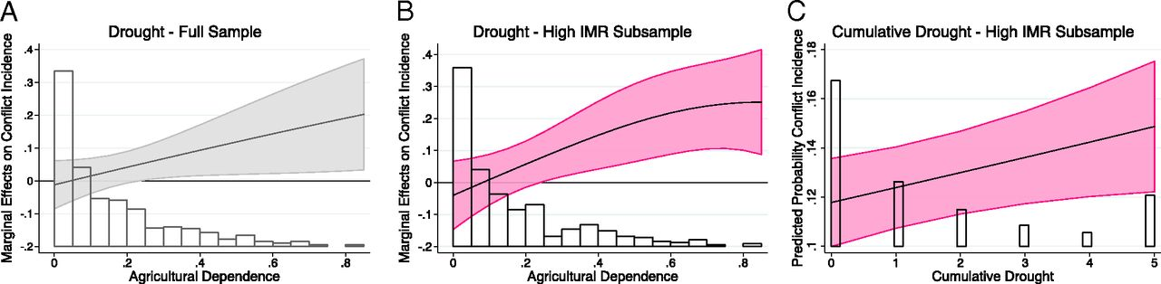
Increased co-location of food insecurity with conflict
Resilience
Over past 2 decades, conflict-affected countries’ share of stunted children grew from 46% to 79%. (FAO et al. 2017)
According to UNHCR, a record ~69mn forcibly displaced people globally now.
And strong relationship between drought and conflict (von Uexkul et al. 2016 PNAS)

Slide 27
Implications
Rapid expected food demand growth of coming decades, esp. in Africa, creates opportunities for food system transformation to address and avoid the emergent ‘tale of two transitions’ problem: boost labor productivity in ag and throughout value chain, advance sustainable soil/water mgmt, improve nutrition, reduce conflict, build resilience.
Must engage the problem at farm-level, but equally in the post-harvest value chain, around food consumer behaviors, and the social, policy and institutional underpinnings that condition all behaviors.
Ag economists play a crucial role, perhaps especially here in Africa, which will be the biggest locus of 21st century change globally.
I and others look to your community for intellectual leadership on these crucial issues to humankind.

Slide 28
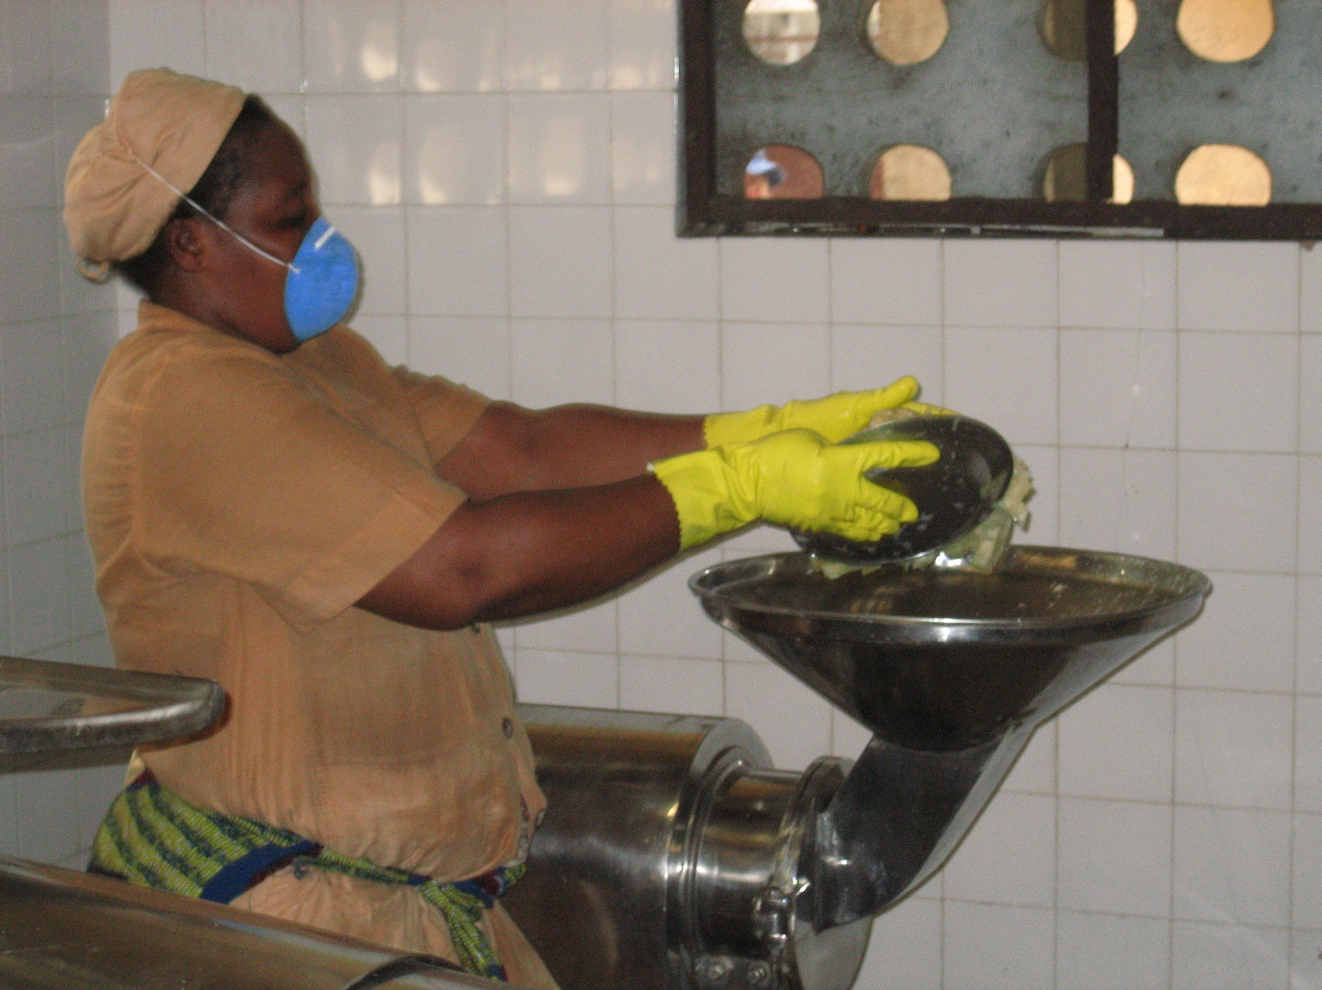
Thank you for your time and interest!

